Slide 1


Project Title-Genetically Optimized CNN for MRI Brain Tumor Classification Project Associates
Don Bosco Institute of Technology
Department of Electronics and Communication Engineering
Apoorva M -1DB20EC007
Deepak C Gowda -1DB20EC025
Goutham B -1DB20EC030
Jayashree A R -1DB20EC038
Guided By Prof. SURESHA H S Associate professor Dept. of ECE, DBIT

Slide 2
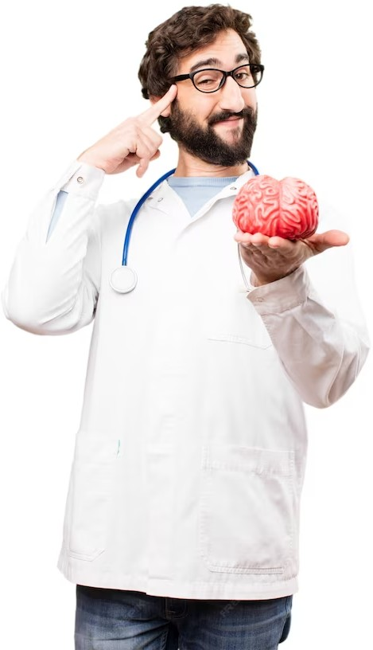
Title: “Genetically Optimized CNN for MRI Brain Tumor Classiﬁcation”

Slide 3
CONTENTS
ABSTRACT
INTRODUCTION
LITERATURE SURVEY
PROBLEM STATEMENT
MOTIVATION
OBJECTIVES
METHODOLOGY
MODULE SPECIFICATION
SOFTWARE REQUIREMENTS
APPLICATIONS
ADVANTAGES
LIMITATIONS
REFERENCES

Slide 4
ABSTRACT
Brain is one of the vital organs in the human body, which consists of billions of cells. The abnormal group of cell is formed from the uncontrolled division of cells, which is also called as tumor.
Brain tumors are classified into low-grade (benign) and high-grade (malignant) categories.
The manual detection of brain tumors is a time-consuming task for healthcare professionals, prompting the need for automated solutions to expedite diagnosis.
Magnetic Resonance Imaging (MRI) facilitates the detection of brain tumors but also offers detailed insights into the structure and anomalies within brain tissue.
This proposes a novel method to detect brain tumors from various brain images by first carrying out different image pre-processing methods and which was followed by a Convolutional Neural Network(CNN).
Deep learning Models have a ability to solve complex relationships without an abundance of nodes distinguishes them from conventional methods, impacting not only brain tumor detection but also extending their influence to medical informatics and bioinformatics.

Slide 5
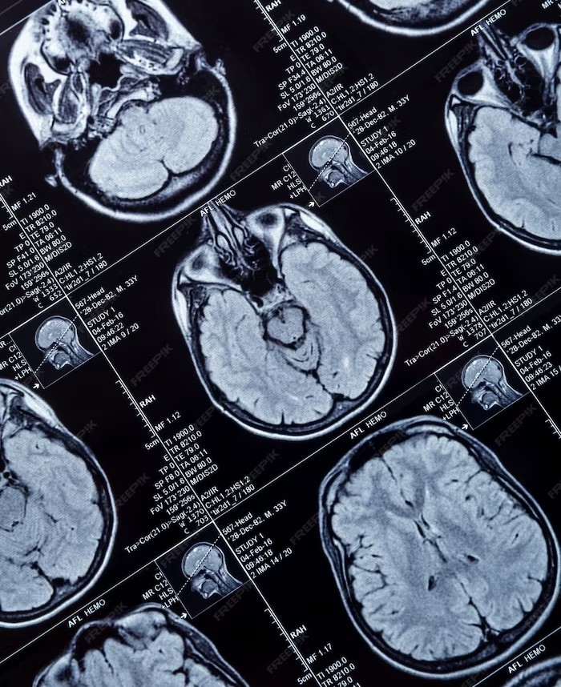
INTRODUCTION
The brain is the most important part of central nervous system.
The main task of the doctors is to detect the tumor which is a time consuming for which they feel burden.
Brain tumor is an intracranial solid neoplasm.
The only optimal solution for this problem is the use of ‘Image segmentation’.
.

Slide 6
LITERATURE SURVEY
Sl No. | List of Author, Title, Publication and year | Highlights | Limitations
1. | Deep Learning Approach for 2D MRI Brain Tumor Segmentation: MOHAMMAD ASHRAF OTTOM, HANIF ABDUL RAHMAN, AND IVO D. DINOV: Date of publication 23 May 2022 | A new approach for MR images segmentation based on the deep learning concept of convolutional network and data augmentation to utilize the available labeled images. | Potential of misidentification of what is supposed to be categorized.
2. | Machine Learning and Deep Learning Approaches for Brain Disease Diagnosis: Principles and Recent Advances PROTIMA KHAN1, MD. FAZLUL KADER, S. M. RIAZUL ISLAM, (Member, IEEE), AISHA B. RAHMAN, MD. SHAHRIAR KAMAL1, MASBAH UDDIN TOHA, AND KYUNG-SUP KWAK: Date of publication February 26, 2021 | The survey reveals some important insights into contemporary passage of time, identification, feature extraction, and classification methods are becoming more challenging in the field of ML. | Brain tumour type can’t be classified Difficult to choose SVM kernel function.

Slide 7
3. | Convolutional Neural Network Based on Complex Networks for Brain Tumor Image Classification With a Modified Activation Function ZHIGUAN HUANG, XIAOHAO DU LIANGMING CHEN YUHE L, MEI LIU, YAO CHOU, AND LONG JIN : Date of publication May 11, 2020 | Medical image analysis is a revolution of practicability and innovative concepts due to the rapid development of hardware, and the use of complex mathematical tools, which can obtain clearly visible medical images. | It doesn’t work well with clusters (in the original) and hard to implement for large scale training samples.
4. | Registration of MRI to Interventional US for Brain-Shift Compensation Using Convolutional Neural Networks: RAMY A. ZEINELDIN (Member, IEEE), MOHAMED E. KARAR (Member, IEEE), ZIAD ELSHAER, MARKUS SCHMIDHAMMER, JAN COBURGER, CHRISTIAN R. WIRTZ, OLIVER BURGERT, AND FRANZISKA MATHIS-ULLRICH: Date of publication October 14, 2021 | Image registration is attractive for providing more information when the imaging data come from different sources and/or different modalities. | It can maximize the margin with respect to features that have already been selected.

Slide 8
PROBLEM STATEMENT
Medical image classification has gained tremendous attention in recent years, and Convolutional Neural Network (CNN) is the most widespread neural network model for image classification problems.
CNN is designed to determine features adaptively through backpropagation by applying numerous building blocks, such as convolution layers, pooling layers, and fully connected layers.
Here we mainly focused on developing a CNN model for classifying brain tumors in T1-weighted contrast-enhanced MRI images.

Slide 9
MOTIVATION
The motivations of the work area:
High speed to diagnose bugs
High accurate results
Take small period to diagnose
Helping medical specialist to identify and cure disease in early stages
Time and life savage

Slide 10
OBJECTIVES
The main aim of the system is to enhance the early detection of brain tumors through a Convolutional Neural Network (CNN)-based approach, specifically utilizing Magnetic Resonance Imaging (MRI) images.
The objective is to provide an effective and reliable tool for the early detection of brain tumors with high Accuracy rate. Ensure precise classification outputs, distinguishing between tumor and normal brain images.
Strategically reduce computation time without compromising accuracy by utilizing a CNN model. This aims to enhance the overall efficiency of the classification process.
Leverage the power of deep learning techniques, particularly CNN, known for its ability to recognize different patterns, enhances flexibility and adaptability in the proposed brain tumor classification system.

Slide 11
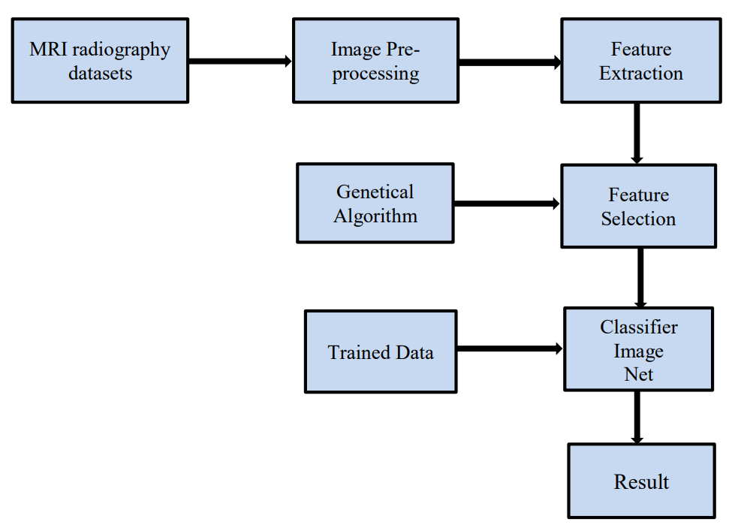
METHODOLOGY
Image Preprocessing allows running many deep learning algorithms and machine learning parallel to choosing the best algorithm.
Image classification datasets are often more significant. Feature extraction is a technique to reduce the number of features in a dataset by creating new features from existing ones.
Figure: Overview of Proposed Deep Learning Model

Slide 12
MACHINE LEARNING- A DEFINITION Machine learning is an application of AI that enables systems to learn and improve from experience without being explicitly programmed. Machine learning focuses on developing computer programs that can access data and use it to learn for themselves. WHY IS MACHINE LEARNING IMPORTANT? ML has proven valuable because it can solve problems at a speed and scale that cannot be duplicated by the human mind alone. With massive amounts of computational ability behind a single task or multiple specific tasks, machines can be trained to identify patterns in and relationships between input data and automate routine processes. ML provides the foundation for AI systems that automate processes and solve data-based business problems autonomously. It enables companies to replace or augment certain human capabilities. Common machine learning applications you may find in the real world include chatbots, self-driving cars and speech recognition.

Slide 13
DEEP LEARNING- A DEFINITION In deep learning, a computer model learns to perform classification tasks directly from images, text, or sound. Deep learning models can achieve state-of-the-art accuracy, sometimes exceeding human-level performance. Models are trained by using a large set of labeled data and neural network architectures that contain many layers. HOW DEEP LEARNING WORKS? Deep learning models are trained by using large sets of labelled data and neural network architectures that learn features directly from the data without the need for manual feature extraction. One of the most popular types of deep neural networks is known as convolutional neural networks . A CNN convolves learned features with input data, and uses 2D convolutional layers, making this architecture well suited to processing 2D data, such as images. CNNs eliminate the need for manual feature extraction, so you do not need to identify features used to classify images. The CNN works by extracting features directly from images. The relevant features are not pretrained; they are learned while the network trains on a collection of images. This automated feature extraction makes deep learning models highly accurate for computer vision tasks such as object classification.

Slide 14
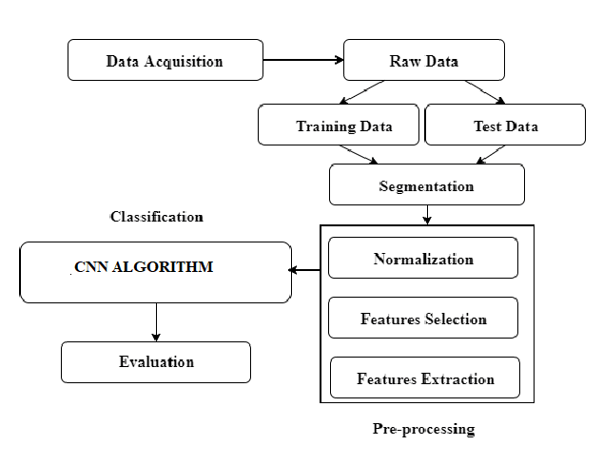
FLOWCHART
Preprocessing: Preprocessing is needed as it provides improvement in image data which enhances some of the image features which are important for further processing.
The pre-processing steps that are applied to MR image are as follows :
The median filter is applied for noise removal from brain MR images.
The noise is to removed for further processing as high accuracy is needed.
Then edges are detected from filtered image using canny edge detection.
The edge detected image is needed for segmentation of the image. Then watershed segmentation is done for finding the location of the tumor in the brain image .
Segmentation is the process of dividing an image into multiple segments.

Slide 15
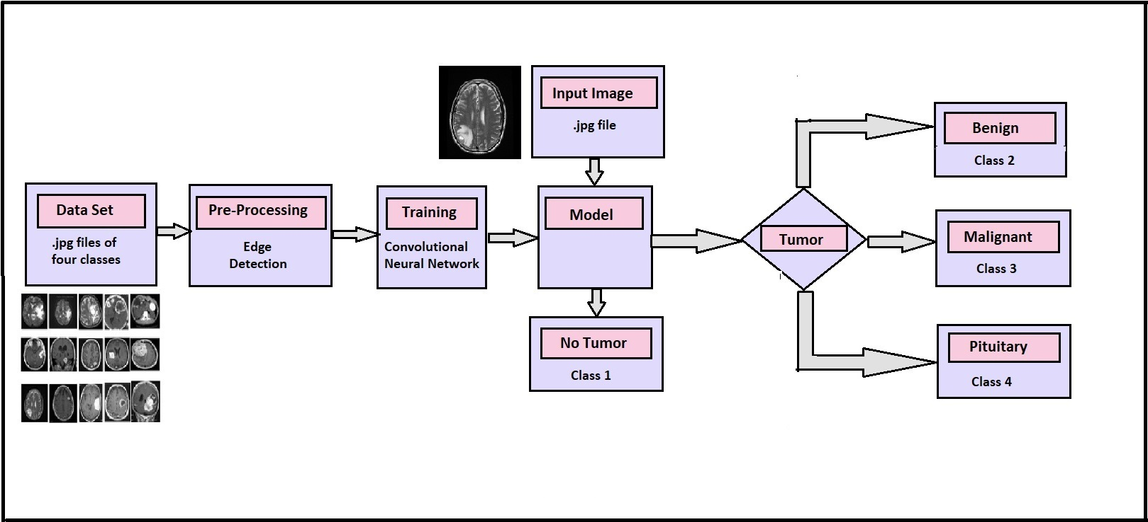
ARCHITECTURE DIAGRAM

Slide 16
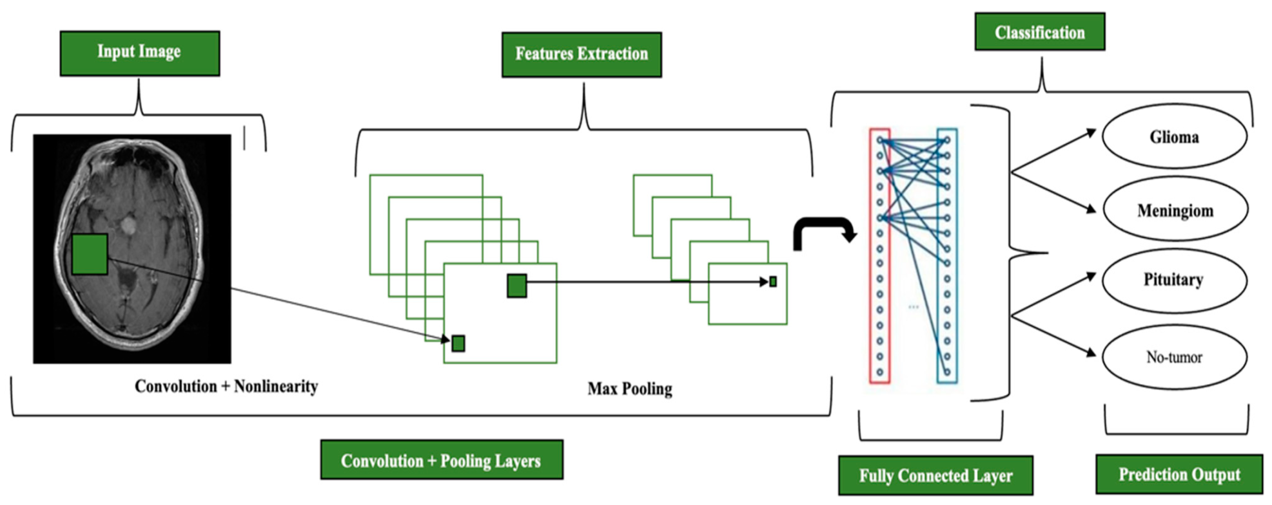
ARCHITECTURE DESIGN

Slide 17
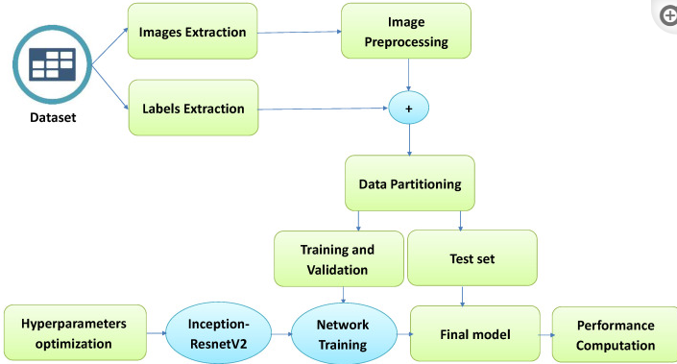
DATA FLOW DIAGRAM

Slide 18
MODULE SPECIFICATION
Dataset collection: Dataset is collected from Kaggle related to brain tumor disease
Data Processing: Data has to be processed to remove the null values and standard scalar function. Features are selected and divided into training and testing dataset.
Module Creation using clustering algorithm: Machine learning algorithm and deep learning algorithms like CNN algorithms are used to create a model
Image Pre-Processing Module : The main functionality of this module is to convert the RGB image to binary format for faster processing. The aim of pre-processing is to enhances some image features important for further processing, although geometric transformations of images (e.g. rotation, scaling, translation) are classified among pre-processing methods.
Segmentation Module : It is to obtain segmented matrix from binary image performing masking. Segmentation is a process of identifying the cancerous brain tissues and labeling them automatically based on the tumor types.
Feature Extraction Module : This module is to apply principle component analysis and obtain Statistical values. It involves the automatic identification and extraction of distinctive features, such as edges, textures, or shapes, from raw input image.
Classification Module : The main functionality of this module is to calculate minimum distance. It learns to extract relevant features from input images and map them to the corresponding classes, enabling accurate image classification.
Convolution Matrix : It is to calculate minimum distance value and to recognize the corresponding image. Using multiple convolution layers in a CNN allows the network to learn increasingly complex features from the input image or video.
User Interface :User application is built using python.

Slide 19
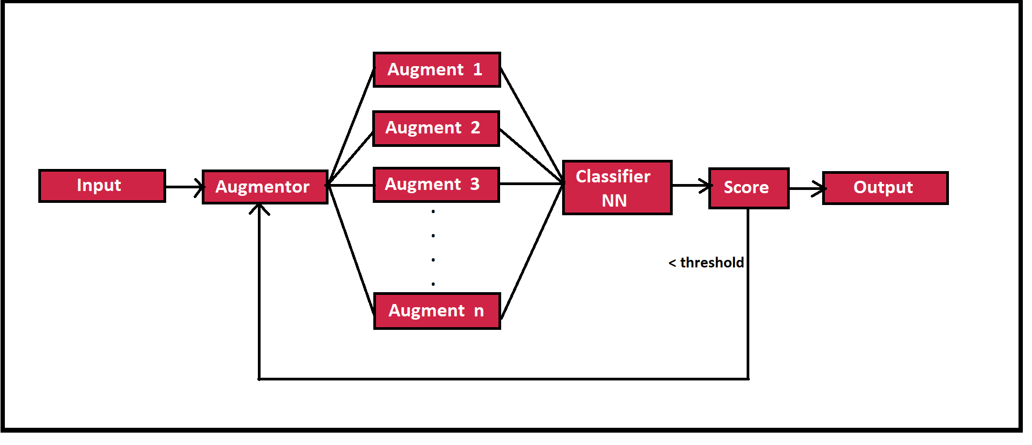
MODEL ARCHITECTURE
The model gets MRI as input. It augments the image into ’n’ different images.
The ’n’ different images are fed to the Neural Network for classification.
The network classifies images into four classes. Then we take votes from each class. If vote is greater than threshold vote confidence, we declare that class label as the output.
If the threshold is not met, generate new ’n’ images and they are again sent to NN.
This process is executed until, the threshold vote confidence is met or no of tries(’t’) is reached..

Slide 20
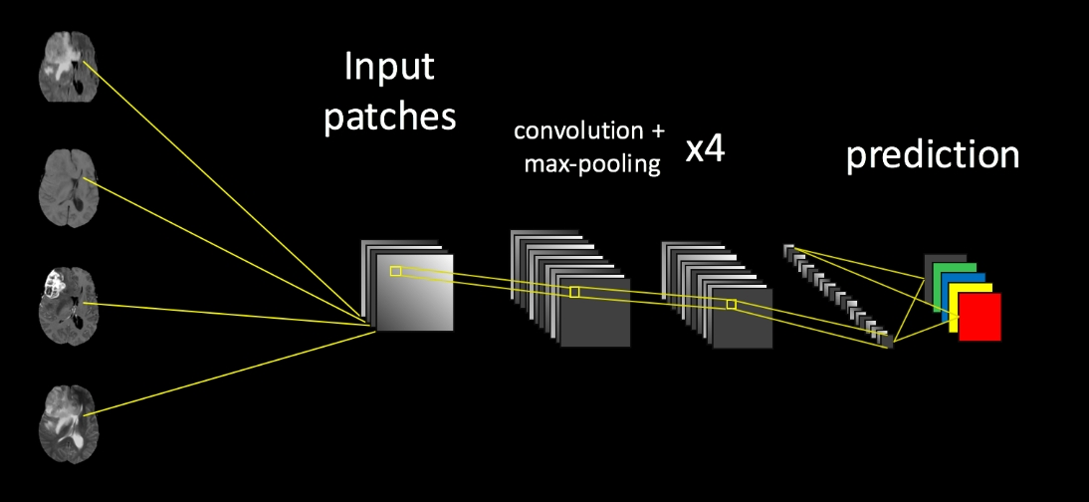
Figure : Abstract Structure of model

Slide 21
PRE - Processing Stage:
Gray Scaling
Reduce the images to gray spectrum.
Helps reduce complexity of images.
Resizing
Resizing the images to lower resolution.
Helps reduce all images to an uniform dimension.
Augmentation
Generating multiple images from a single image.
Helps create more data set for training.
Edge Detection
Using edge detection algorithms like Canny, Prewitt.
Helps highlight tumor part in image.

Slide 22
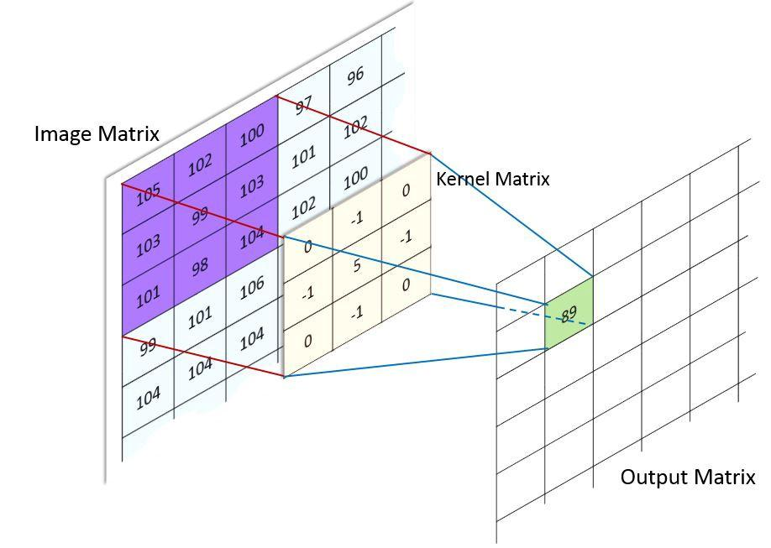
CNN Model Design and its parameters.
Structure
Similar to ANN with addition of Convolution and Pooling.
Convolution
It is a kernel filter for feature extraction.
Provides a pooled feature map.
Pooling
Its a function to reduce the amount of parameters in network.

Slide 23
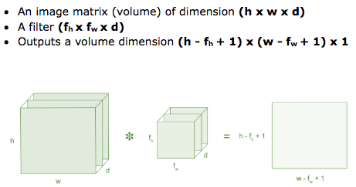
Mathematical Model
1. Convolution

Slide 24
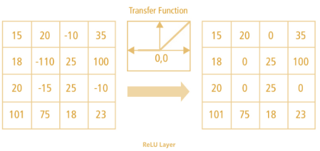
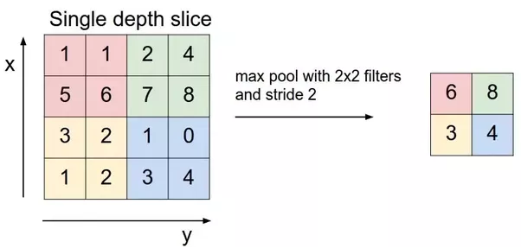
2.ReLU The output of relu is f(x) = 3. Max Pooling The output of max pooling is f(x) = max x[m,n])
0 if x<0
X if x>=0

Slide 25
ALGORITHM USED
The proposed brain tumor classification system leverages Convolution Neural Network (CNN) architecture, a specialized form of neural network. CNN is adapt to handle 3D input volumes, making it suitable for scalable image processing.
The model adopts a strategic approach by training only the last layer during the Python implementation. This optimization minimizes computation time without compromising performance.
Hence the complexity and computation time is low and accuracy is high.
The proposed system ensures a balance between accuracy and computational efficiency, offering a robust solution for automatic brain tumor classification.
ResNet is a popular deep residual learning framework that is widely used in brain tumor detection using Convolutional Neural Networks (CNNs).

Slide 26
IMPLEMENTATION
Implementation is the process of converting a new system design into an operational one. It is the key stage in achieving a successful new system. It must therefore be carefully planned and controlled.
Front-End Development Using Python Flask
Flask Programming
Python
Pip
Pandas
Anaconda
Jupyter Notebook
Tensorflow
Keras
OpenCV

Slide 27
HARDWARE & SOFTWARE REQUIREMENTS
Hardware
System : Pentium IV 2.4 GHz.
Hard Disk : 40 GB.
Monitor : 15 VGA Color.
Ram : 4GB
Software
Operating system : Windows 10 / Linux
Coding Language : Python 3.7
Toolbox : IDLE, Visual studio

Slide 28
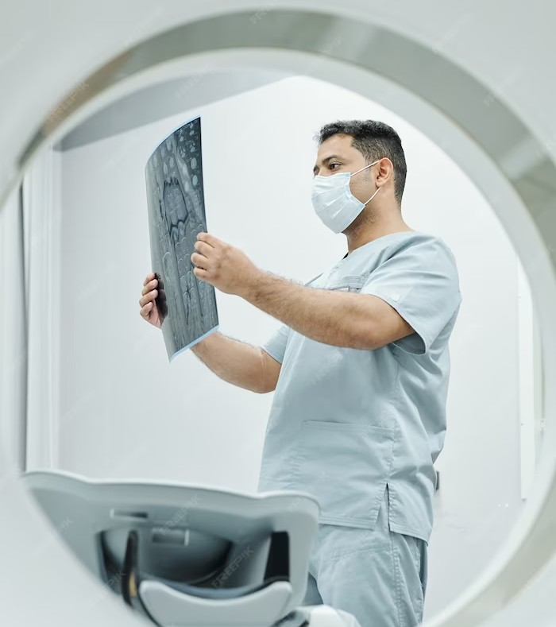
APPLICATIONS
The primary application is the early and accurate diagnosis of brain tumors.
Brain tumor classification assists in treatment planning.
The system can stratify patients based on the type and characteristics of their brain tumors.
Radiologists can benefit from the system as a supportive tool in their diagnostic workflow.
.

Slide 29
ADVANTAGES
The Advantages Include:
The integration of Genetic Algorithms and CNNs allows for more accurate brain tumor classification.
Genetic Algorithms intelligently select the most discriminative features from MRI scans, reducing the dimensionality of the data while preserving critical information
Radiologists can benefit from the system as a supportive tool in their diagnostic workflow.
The proposed system automates the process of brain tumor classification, reducing the reliance on manual interpretation by radiologists.

Slide 30

CONCLUSION
The project introduces a convolution neural network (CNN) based brain tumor classification scheme, aiming to overcome the limitations of conventional methods. The integration of CNN facilitates improved accuracy, efficiency and performance compared to existing approaches, addressing the challenges posed by texture and shape feature extraction, SVM, and DNN-based methods. The classification results generated by the proposed CNN-based scheme offer clear distinctions between tumor and normal brain images. These model collectively underscore the robustness and reliability of the proposed scheme, positioning it as a promising advancement in automatic brain tumor classification.
.

Slide 31
FUTURE SCOPE
Improved Diagnostics.
Covering more number of classes of Brain Tumor.
Accurate Growth Rate Prediction of Tumor.
Reduction in Medical Negligence.

Slide 32
REFERENCES
1.Brain Tumor Classification in MRI Images Using Genetic Algorithm Appended CNN, T. BALAMURUGAN, E. GNANAMANOHARAN: IEEE@2023 Computer Assisted Methods in Engineering and Science 30(3): 305–321, 2023, DOI: 10.24423/cames.649.
2. Deep Learning Approach for 2D MRI Brain Tumor Segmentation: MOHAMMAD ASHRAF OTTOM, HANIF ABDUL RAHMAN, AND IVO D. DINOV: Date of publication 23 May 2022.
3. Machine Learning and Deep Learning Approaches for Brain Disease Diagnosis: Principles and Recent Advances PROTIMA KHAN1, MD. FAZLUL KADER, S. M. RIAZUL ISLAM, (Member, IEEE), AISHA B. RAHMAN, MD. SHAHRIAR KAMAL1, MASBAH UDDIN TOHA, AND KYUNG-SUP KWAK: Date of publication February 26, 2021.
4. Convolutional Neural Network Based on Complex Networks for Brain Tumor Image ClassificationWith a Modified Activation Function ZHIGUAN HUANG, XIAOHAO DU LIANGMING CHEN YUHE L, MEI LIU, YAO CHOU, AND LONG JIN : Date of publication May 11, 2020.
5. Registration of MRI to Interventional US for Brain-Shift Compensation Using Convolutional Neural Networks: RAMY A. ZEINELDIN (Member, IEEE), MOHAMED E. KARAR (Member, IEEE), ZIAD ELSHAER, MARKUS SCHMIDHAMMER, JAN COBURGER, CHRISTIAN R. WIRTZ, OLIVER BURGERT, AND FRANZISKA MATHIS-ULLRICH: Date of publication October 14, 2021

Slide 33
THANK YOU

